Slide 1


AGE 316:
MICROCOMPUTER SYSTEMS
LECTURE 3: ELECTRONICS & DIGITAL I/O
Dr. Kadeghe Fue
Department of Agricultural Engineering

Slide 2


Recap: Lecture 2
ATmega328P: The brain of the Arduino Uno.
Memory: Flash (Code) vs. SRAM (Variables).
I/O Pins: Digital (0-13) and Analog (A0-A5).
Power: 5V USB or 7-12V DC Jack.
Ready to power up?

Slide 3




Understanding Electricity
Before we can program the microcontroller, we must understand the flow of energy that powers it.
Voltage
Current
Resistance

Slide 4


The Water Tank Analogy
Think of electricity like water flowing through a pipe:
•
Voltage (V): Water Pressure. The "push" from the tank.
•
Current (I): Water Flow Rate. How much water is moving.
•
Resistance (R): Pipe Width. A thin pipe resists flow more than a wide one.

Slide 5





The Golden Rule: Ohm's Law
The relationship between Voltage, Current, and Resistance is defined by:
V (Volts)
I (Amperes)
R (Ohms Ω)

Slide 6

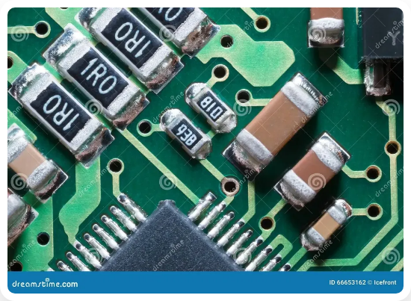
Component 1: The Resistor
Function
Limits the flow of current in a circuit. Used to protect sensitive components (like LEDs).
Identification
Values are marked with Color Bands.
Unit:

Slide 7

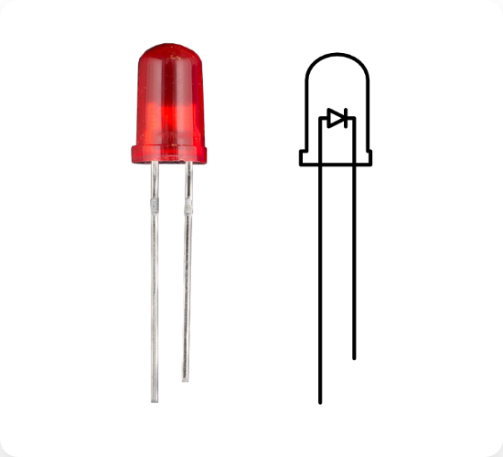
Component 2: The LED
Light Emitting Diode
A semiconductor that emits light when current flows through it.
Polarity Matters!
Anode (+): Long leg. Connect to positive voltage.
Cathode (-): Short leg/Flat side. Connect to Ground (GND).

Slide 8

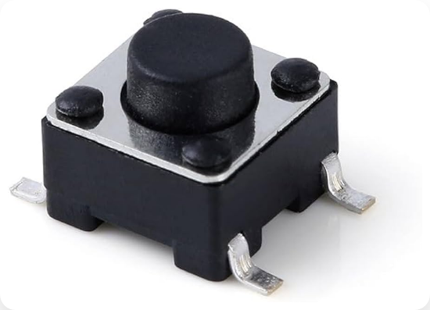
Component 3: The Push Button
Tactile Switch
A simple mechanical switch that closes a circuit when pressed.
Function
Used as a Digital Input device. It tells the Arduino when a user has interacted with the system.
State: Open (Disconnected) vs. Closed (Connected).

Slide 9

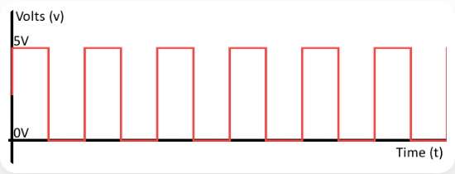


Digital vs. Analog Logic
The Binary World
In digital electronics, there are only two states:
HIGH
LOW
A Digital Signal (Square Wave)

Slide 10


Arduino Function: pinMode()
Configures a specific pin to behave either as an input or an output.
void
setup
// Configure pin 13 to drive an LED
pinMode
OUTPUT
// Configure pin 2 to read a button
pinMode
INPUT
Note: This is usually done once in the setup() function.

Slide 11


Arduino Function: digitalWrite()
Write a HIGH or a LOW value to a digital pin. Used to turn things On or Off.
void
loop
digitalWrite
HIGH
// Turn LED ON (5V)
delay
digitalWrite
LOW
// Turn LED OFF (0V)
delay

Slide 12

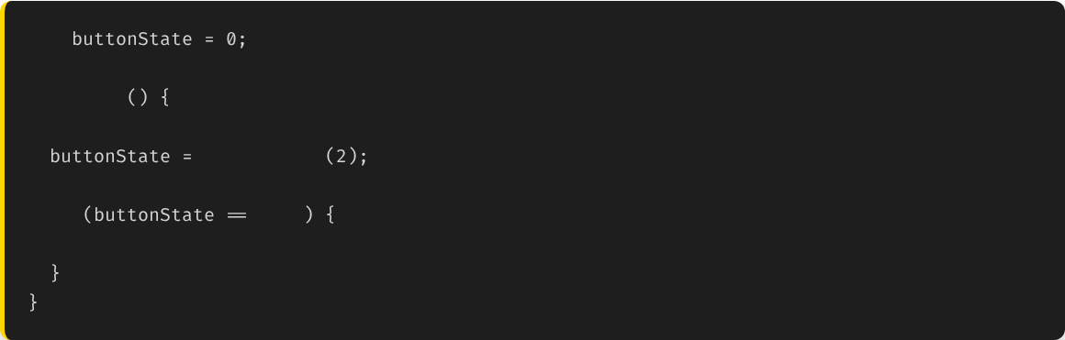
Arduino Function: digitalRead()
Reads the value from a specified digital pin, either HIGH or LOW.
int
void
loop
// Read the state of the button
digitalRead
if
HIGH
// Button is pressed...

Slide 13

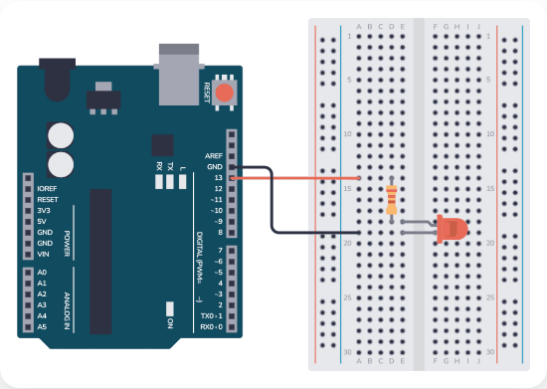
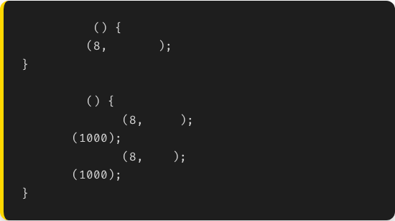
Project: The "Blink" Sketch
The "Hello World" of hardware. This code makes an external LED blink on and off.
void
setup
pinMode
OUTPUT
void
loop
digitalWrite
HIGH
delay
digitalWrite
LOW
delay

Slide 14
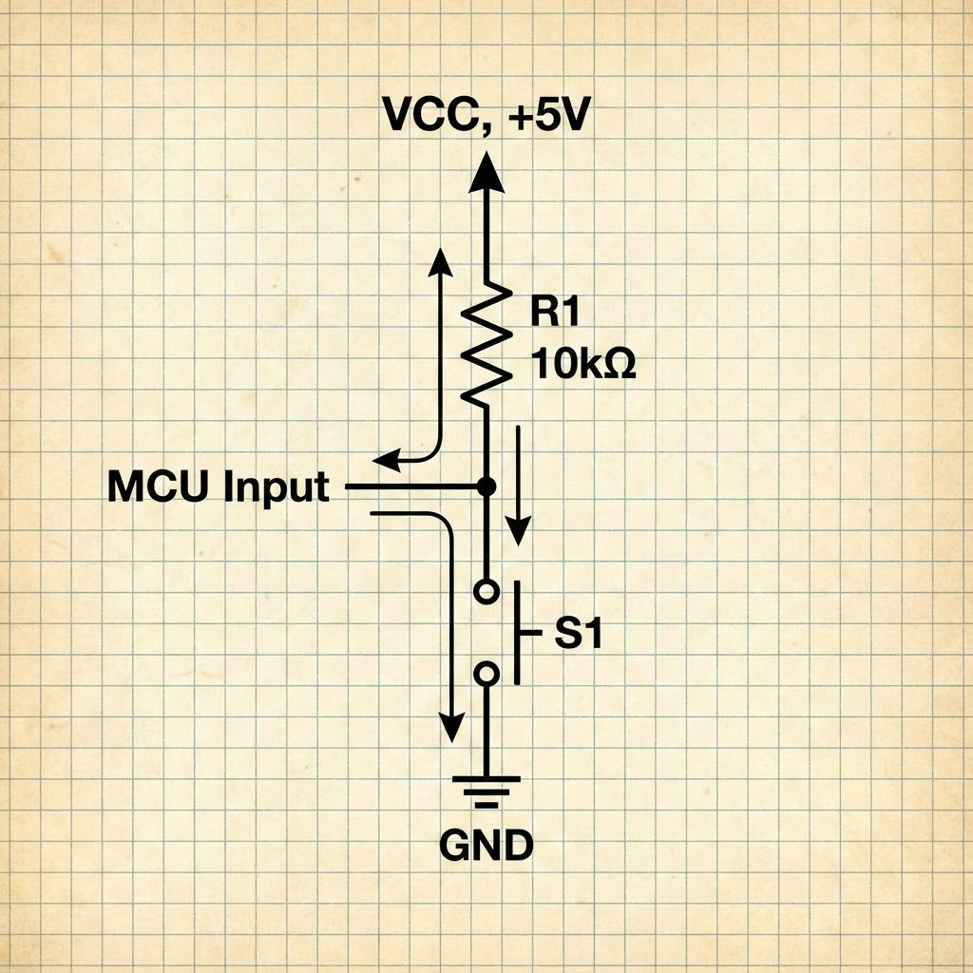
Concept: Floating Pins
The Problem
When a switch is open, the input pin is not connected to anything. It is "Floating".
It can randomly read HIGH or LOW due to electrical noise.
The Solution
Use a Pull-up Resistor (usually 10kΩ) to pull the pin to 5V when the switch is open.

Slide 15







Summary
Basics
Components
Logic
Voltage, Current, and Resistance (V=IR) govern all circuits.
Resistors limit flow. LEDs emit light. Buttons provide input.
pinMode, digitalWrite, and digitalRead are the core I/O functions.

Slide 16


Lab Preparation
Bring your Arduino Kit (Board, USB, Breadboard, Wires, LEDs, Resistors).
Have Arduino IDE installed.
We will build the Blink Circuit physically in the lab!

Slide 17

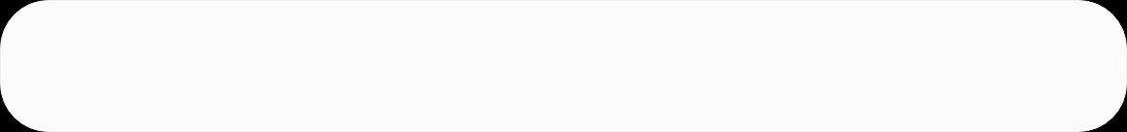
Questions?
"The only stupid question is the one you don't ask."
Dr. Kadeghe Fue
Sokoine University of Agriculture

Slide 18




Image Sources
https://upload.wikimedia.org/wikipedia/en/c/c1/SUA.png
Source: wikipedia.org
https://cdn.sparkfun.com/assets/e/8/8/4/8/5113d1c3ce395fc87d000000.png
Source: learn.sparkfun.com
https://www.anypcba.com/upfile/blogs/articles/477/smd-resistors-closeup.webp
Source: www.anypcba.com
https://soldered.com/productdata/2023/03/led-image-and-graph.png
Source: soldered.com
https://m.media-amazon.com/images/I/411dm8zkgBL._AC_UF894,1000_QL80_.jpg
Source: amazon.com
https://www.dosupply.com/tech/wp-content/uploads/2019/01/digital-signal.png
Source: www.dosupply.com

Slide 19



Image Sources
https://www.build-electronic-circuits.com/wp-content/uploads/2023/07/Arduino-LED.png
Source: www.build-electronic-circuits.com
https://cdn.sparkfun.com/assets/6/f/b/c/7/511568b6ce395f1b40000000.jpg
Source: learn.sparkfun.com

